Slide 1
Chapter 10
Object-Oriented Thinking

Slide 2
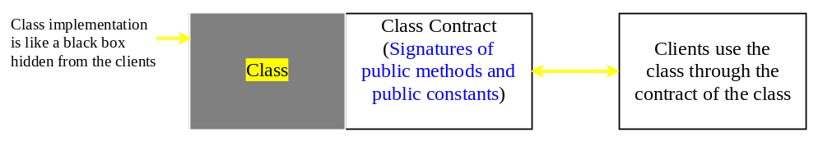
Class Abstraction and Encapsulation
Class abstraction means to separate class implementation details from the use of the class. The creator of the class provides a description of the class and let the user know how the class can be used. The user of the class does not need to know how the class is implemented. The detail of implementation is encapsulated (hidden) from the user.

Slide 3
Visibility Modifiers
public
private
Violate
encapsulation
Enforce
encapsulation
Variables
Provide services
to clients of the class
Support other
methods in the
class
Methods

Slide 4
Designing the Loan Class
A Loan is characterized by:
- amount
- interest rate
- start date
- duration (years)
- monthly payment (need to be computed)
- total payment (need to be computed)
Each real-life loan is a loan object with specific values for those characterizes. (e.g., car loan, mortgage, personal loan, etc.)
To program this concept, we need to define class Loan with data fields (attributes) and methods.

Slide 5
Designing the Loan Class
To achieve encapsulation, we need the following:
1. Define all variables to be private. No exceptions.
2. Define get (getter) and set (setter) methods for each private variable that users of the class need to access (as public methods).
3. Methods that users of the class need to know about must be defined as public.
4. Support methods must be defined as private.
5. All class methods have access to its variables.

Slide 6
UML modeling of class Loan
Loan
-
annualInterestRate: double
The annual interest
rate of the loan (default: 2.5).
-
numberOfYears: int
The number of years for the loan (default: 1)
-
loanAmount: double
The loan amount (default: 1000).
-
loanDate: Date
The date this loan was created.
+Loan()
Constructs a
default Loan object.
+Loan(annualInterestRate: double,
Constructs a loan with specified interest rate, years, and
numberOfYears: int,
loan amount.
loanAmount: double)
+getAnnualInterestRate(): double
Returns the annual interest rate of this loan.
+getNumberOfYears(): int
Returns the number of the years of this loan.
+getLoanAmount(): double
Returns the amount of this loan.
+getLoanDate(): Date
Returns the date of the creation of this loan.
+setAnnualInterestRate(
Sets a new annual interest rate to this loan.
annualInterestRate: double): void
Sets a new number of years to this
loan.
+setNumberOfYears(
numberOfYears: int): void
Sets a new amount to this loan.
+setLoanAmount(
loanAmount: double): void
Returns the monthly payment of this loan.
+
getM
onthlyPayment(): double
Returns the total payment of this loan.
+
getT
otalPayment(): double
Class Loan and class TestLoanClass start on page 367.

Slide 7
Class TestLoanClass
import java.util.Scanner;
public class TestLoanClass {
public static void main(String[] args) { // Main method
Scanner input = new Scanner(System.in); // Create a Scanner
// Enter yearly interest rate
System.out.print("Enter yearly interest rate, for example, 8.25: ");
double annualInterestRate = input.nextDouble();
// Enter number of years
System.out.print("Enter number of years as an integer: ");
int numberOfYears = input.nextInt();
// Enter loan amount
System.out.print("Enter loan amount, for example, 120000.95: ");
double loanAmount = input.nextDouble();
// Create Loan object
Loan loan = new Loan(annualInterestRate, numberOfYears, loanAmount);
// Display loan date, monthly payment, and total payment
System.out.printf(
"The was loan created on: " + loan.getLoanDate().toString() + "\n" +
"The monthly payment is: " + loan.getMonthlyPayment() + "\n" +
"The total payment is: " + loan.getTotalPayment());
}
}

Slide 8
Class Loan Constructor Methods
// see complete class code on page 368
// Default constructor
public Loan() {
this(2.5, 1, 1000); // calls the second constructor to create
// a loan object with default values. This is same as:
// annualInterestRate = 2.5;
// numberOfYears = 1;
// loanAmount = 1000;
// Construct a loan with specified rate, number of years, and amount
public Loan(double annualInterestRate, int numberOfYears, double
loanAmount) {
this.annualInterestRate = annualInterestRate;
this.numberOfYears = numberOfYears;
this.loanAmount = loanAmount;
loanDate = new java.util.Date(); // creates date object
}

Slide 9
Object-Oriented Thinking
In procedural languages, the data is separated from the methods (or procedures). Data is passed on to the procedure whenever we need to process the data.
In Object-Oriented (OO) programming, data and the methods needed to process the data are encapsulated together forming so called Objects.
In OO programming, classes provide more flexibility and modularity for building software applications.
OO programming has the benefits of developing reusable code using objects and classes.

Slide 10
Example: Class BMI
BMI
-
name
: String
The name of the person.
-
age: int
The age o
f the person.
-
weight
:
double
The weight of the person
in pounds
.
-
height
:
double
The height of the person
in inches
.
+BMI(name: String, age: int, weight:
Creates a BMI object with the specified
double, height: double)
name, age, weight, and height.
+BMI(name: String, weight: double,
Creates a BMI object with the specified
height: double)
name, weight, height, and a default age 20
+getBMI(): double
Returns the BM
I
+getStatus():
String
Returns the BMI status (e.g., normal, overweight, etc.)
+getName(): String
Return name
+getAge(): int
Return age
+getWeight(): double
Return weight
+getHeight(): double
Return height

Slide 11
The BMI Class Code
public class BMI {
private String name;
private int age;
private double weight; // in pounds
private double height; // in inches
public static final double KILOGRAMS_PER_POUND = 0.45359237;
public static final double METERS_PER_INCH = 0.0254;
// constructors
public BMI(String name, int age, double weight, double height) {
this.name = name;
this.age = age;
this.weight = weight;
this.height = height; }
public BMI(String name, double weight, double height) {
this(name, 20, weight, height);
}
// getters
public String getName() { return name; }
public int getAge() { return age; }
public double getWeight() { return weight; }
public double getHeight() { return height; }
// continue next slide
this.name = name;
this.age = 20;
this.weight = weight;
this.height = height;

Slide 12
The BMI Class Code
// compute PMI
public double getBMI() {
double bmi = weight * KILOGRAMS_PER_POUND /
((height * METERS_PER_INCH) * (height * METERS_PER_INCH));
return Math.round(bmi * 100) / 100.0;
}
// determine status
public String getStatus() {
double bmi = getBMI();
if (bmi < 18.5)
return "Underweight";
else if (bmi < 25)
return "Normal";
else if (bmi < 30)
return "Overweight";
else
return "Obese";
}
}

Slide 13
The Test Program
public class UseBMIClass {
public static void main(String[] args) {
BMI bmi1 = new BMI("John Doe", 18, 145, 70);
System.out.println("The BMI for " + bmi1.getName() + " is "
+ bmi1.getBMI() + " " + bmi1.getStatus());
BMI bmi2 = new BMI("Peter King", 215, 70);
System.out.println("The BMI for " + bmi2.getName() + " is "
+ bmi2.getBMI() + " " + bmi2.getStatus());
}
}
----jGRASP exec: java UseBMIClass
The BMI for John Doe is 20.81 Normal
The BMI for Peter King is 30.85 Obese
----jGRASP: operation complete.

Slide 14
Class Relationships
Classes can be related in an OO program. Common relationships among classes are:
- Association:
When a class is associated with (makes use of) another class.
- Aggregation and Composition:
Association that implies ownership (has-a relationship).
Composition means exclusive ownership (uniqueness)
- Inheritance (discussed in Chapter 11):
When a class is defined from (builds on) an existing class.
This is also know as parent/child (supercalss/subclass) relationship

Slide 15
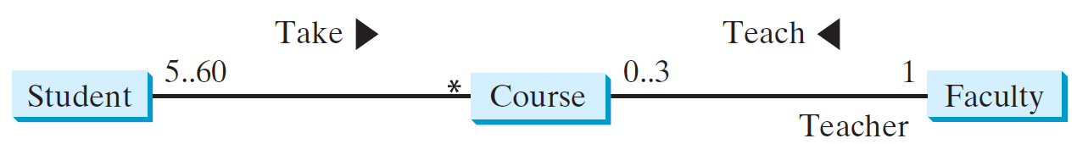
Association
It is a binary relationship that describe an activity between 2 classes.
It shows number of participating objects (multiplicity) in the relationship.
For example,
1 faculty teaches 0 to 3 courses.
0 to 3 courses may be taught by 1 faculty.
1 student can take many (*) courses.
1 course can have 5 to 60 students.

Slide 16
Implementation of Association
Using Methods and Data Fields
public class Student{
private Course[] courseList;
public void addCourse(Course courseName) { //method details... }
// other content
}
public class Course{
private Student[] classList;
private facultyName;
public void addStudent(Student studentName) { //method details... }
public void setFaculty(Faculty facultyName) { //method details... }
// other content
}
public class Faculty{
private Course[] classList;
public void addCourse(Course courseName) { //method details... }
// other content
}

Slide 17
Aggregation and Composition
Aggregation (has-a relationship) is when an object has ownership of another object that may be owned by other objects.. (e.g., a student has an address that is also the address of other students (roommates).
Composition is an aggregation relationship that implies exclusive ownership (e.g., a student has a name that is unique for each student).
Both relationships are implemented using data fields.

Slide 18
Aggregation/Composition Implementation Using Data Fields
A student has a name that is unique to each student.
A student has an address that may be shared by other students.
Public class Name {
Public class Students {
Public class Address {
...
private
Name name;
...
}
Private Address address;
}
...
}
Aggregated Class
Aggregating Class
Aggregated Class

Slide 19
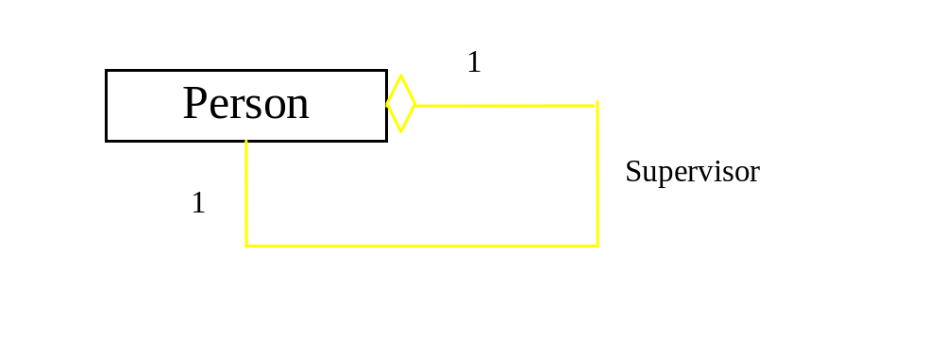
Aggregation Between Same Class
Aggregation may exist between objects of the same class. For example, a person may have a supervisor.
public class Person {
// The type for the data is the class itself
private Person supervisor;
// Other content
}

Slide 20
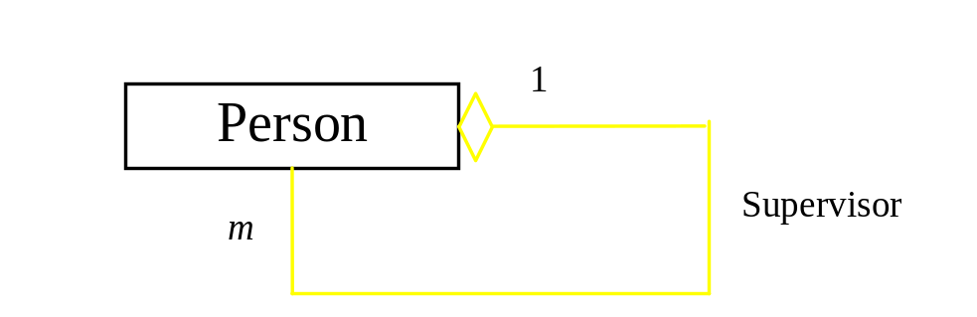
Aggregation Between Same Class
What happens if a person has several supervisors?
public
class
Person {
...
private
Person
[]
supervisors;
}

Slide 21
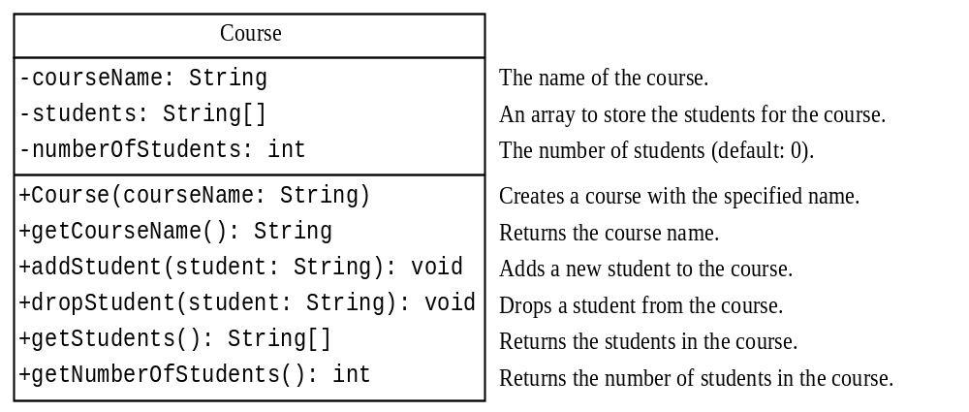
Example: The Course Class
Class TestCourse and class Course start on page 376.

Slide 22
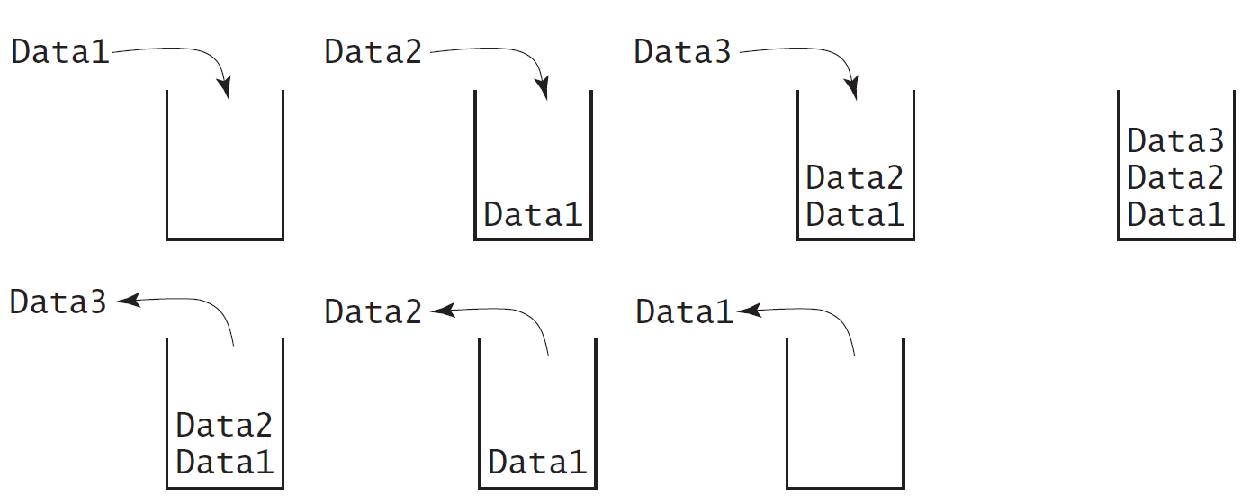
Designing the StackOfIntegers Class

Slide 23
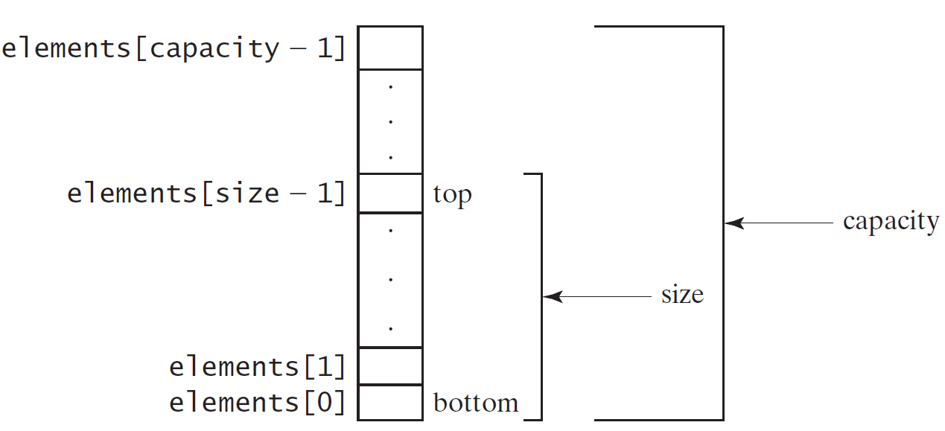
Implementing StackOfIntegers Class

Slide 24
Example: The StackOfIntegers Class
StackOfIntegers
-
elements: int[]
An array to store integers in the stack.
-
size: int
The number of
integers in the stack.
+StackOfIntegers()
Constructs an empty stack with a default capacity of 16.
+StackOfIntegers(capacity: int)
Constructs an empty stack with a specified capacity.
+empty(): boolean
Returns true if the stack is empty.
+peek(): int
Returns the integer at the top of the stack without
+push(value: int): int
Stores an integer
+pop(): int
Removes the integer at the top of the stack and returns it.
+getSize(): int
Returns the number of elements in the stack.
Class TestStackOfIntegers and class StackOfIntegers start on page 378.

Slide 25
Wrapper Classes
Stop and Record…

Slide 26
Wrapper Classes
Java primitive types are NOT objects.
Often we need to treat primitive values as objects.
The solution is to convert a primitive type value, such as 45, to an object that hold value 45.
Java provides Wrapper Classes for all primitive types.

Slide 27
Wrapper Classes
Boolean
Character
Short
Byte
Integer
Long
Float
Double
Note:
(1) The wrapper classes do not have no-argument constructors.
(2) The instances (objects) of all wrapper classes are immutable. That is, their internal values cannot be changed once the objects are created.
(3) A wrapper class object contains one value of the class type.

Slide 28
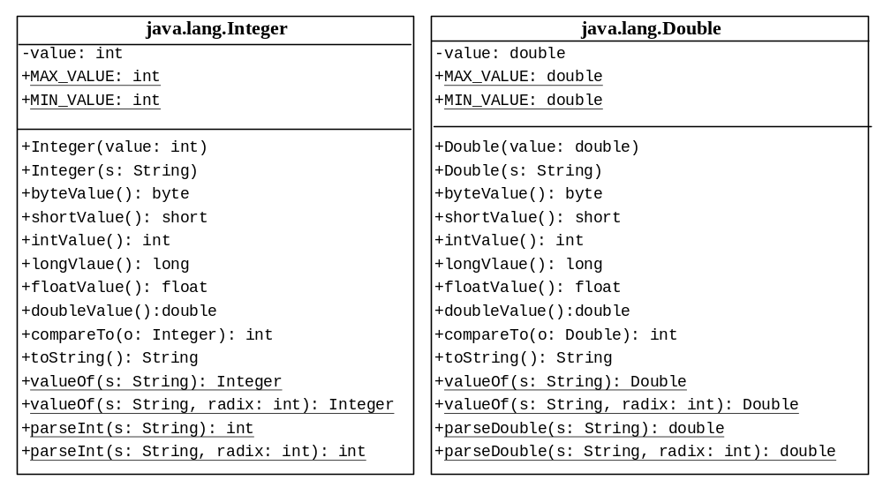
The Integer and Double Classes

Slide 29
Numeric Wrapper Class Constructors
We can construct a wrapper object either from:
1) primitive data type value
2) string representing the numeric value
The constructors for Integer and Double classes are:
      public Integer(int value)
      public Integer(String s)
      public Double(double value)
      public Double(String s)
Examples:
Integer intObject1 = new Integer(90);
Integer intObject2 = new Integer("90");
Double doubleObject1 = new Double(95.7);
Double doubleObject2 = new Double("95.7");
// Similar syntax for Float, Byte, Short, and Long types.

Slide 30
Numeric Wrapper Class Constants
Each numerical wrapper class has 2 constants:
MAX_VALUE: represents the maximum value of the type.
MIN_VALUE: represents the minimum value of the type.
Examples:
  System.out.println("Max integer is: " + Integer.MAX_VALUE);
  System.out.println("Min integer is: " + Integer.MIN_VALUE);
  System.out.println("Max float is: " + Float.MAX_VALUE);
  System.out.println("Min float is: " + Float.MIN_VALUE);
  System.out.println("Max short is: " + Short.MAX_VALUE);
  System.out.println("Min short is: " + Short.MIN_VALUE);
  System.out.println("Max byte is: " + Byte.MAX_VALUE);
  System.out.println("Min byte is: " + Byte.MIN_VALUE);

Slide 31
Conversion Methods
Each numeric wrapper class implements conversion methods that convert an object of a wrapper class to a primitive type:
doubleValue(), floatValue(), intValue()
longValue(), and shortValue().
Examples:
    Double myValue = new Double(97.50);
    System.out.println(myValue.intValue()); //gives 97
    System.out.println(myValue.floatValue()); //gives 97.5
    System.out.println(myValue.shortValue()); //gives 97
    System.out.println(myValue.longValue()); //gives 97

Slide 32
The Static valueOf Methods
The numeric wrapper classes have a useful class method:
valueOf(String s)
This method creates a new object initialized to the value represented by the specified string.
Examples:
  Double doubleObject = Double.valueOf("95.79");
  Integer integerObject = Integer.valueOf("86");
  Float floatObject = Float.valueOf("95.54");
  Long longObject = Long.valueOf("123456789");
  Short shortObject = Short.valueOf("123");
  Byte byteObject = Byte.valueOf("12");

Slide 33
Methods for Parsing Strings into Numbers
Parsing methods allow us to pars numeric strings into numeric types.
Each numeric wrapper class has two overloaded parsing methods:
Public static int parseInt(String s)
Public static int parseInt(String s, int radix)
Examples:
  int A = Integer.parseInt("25"); //A has 25
  System.out.println(A);
  int B = Integer.parseInt("110",2); //B has 6
  System.out.println(B);
  int C = Integer.parseInt("25",8); //C has 21
  System.out.println(C);
  int D = Integer.parseInt("25",10); //D has 25
  System.out.println(D);
  int E = Integer.parseInt("25",16); //E has 37
  System.out.println(E);

Slide 34
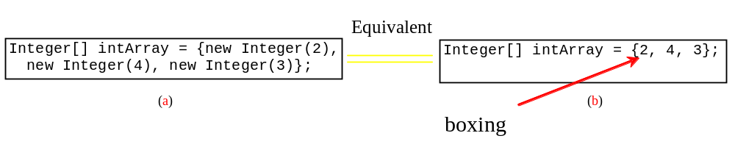
Automatic Conversion
Java allows primitive type and wrapper classes to be converted automatically.
Integer[] intArray = {1, 2, 3};
System.out.println(intArray[0] + intArray[1] + intArray[2]);
Unboxing

Slide 35
BigInteger and BigDecimal Classes
To work with very large integers or high precision floating-point values, you can use the BigInteger and BigDecimal classes in the java.math package.
Examples:
BigInteger bigA = new BigInteger("12345678923456789");
BigInteger bigB = new BigInteger("7");
BigDecimal bigC = new BigDecimal("1245.56789");
BigDecimal bigD = new BigDecimal("2");
System.out.println(bigA.multiply(bigB));
System.out.println(bigC.divide(bigD, 20,BigDecimal.ROUND_UP));
The output is:
86419752464197523
622.78394500000000000000

Slide 36
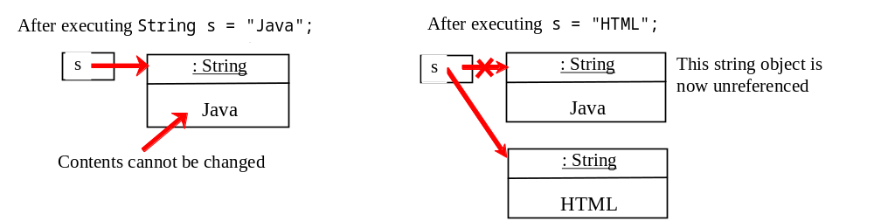
The String Class Revisited
A String object is immutable; its contents cannot be changed.
The following code does NOT change the content of string s.
String s = "Java";
s = "HTML";

Slide 37
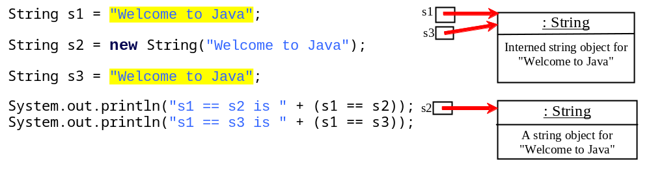
Interned Strings
Since strings are immutable and are frequently used, to improve efficiency and save memory, the JVM uses a unique instance for string literals with the same character sequence. Such an instance is called interned. For example, the following statements:

Slide 38
Convert Character and Numbers to Strings
The String class provides several static valueOf methods for converting a character, an array of characters, and numeric values to strings. These methods have the same name valueOf with different argument types: char, char[], double, long, int, and float.
Examples:
String A = String.valueOf(123);
System.out.println(A);
String B = String.valueOf(23.5);
System.out.println(B);
String C = String.valueOf(true);
System.out.println(C);
char[] x = {'a','b','c'};
String D = String.valueOf(x);
System.out.println(D);
Output:
123
23.5
true
abc

Slide 39
StringBuilder and StringBuffer
The StringBuilder/StringBuffer class is an alternative to the String class.
In general, a StringBuilder/StringBuffer can be used wherever a string is used.
StringBuilder/StringBuffer is more flexible than String. They use string buffer. You can add, insert, or append new contents into the buffer, whereas the value of a String object is fixed once the string is created.
Self study.

Slide 40
End of Chapter 10

